Slide 1
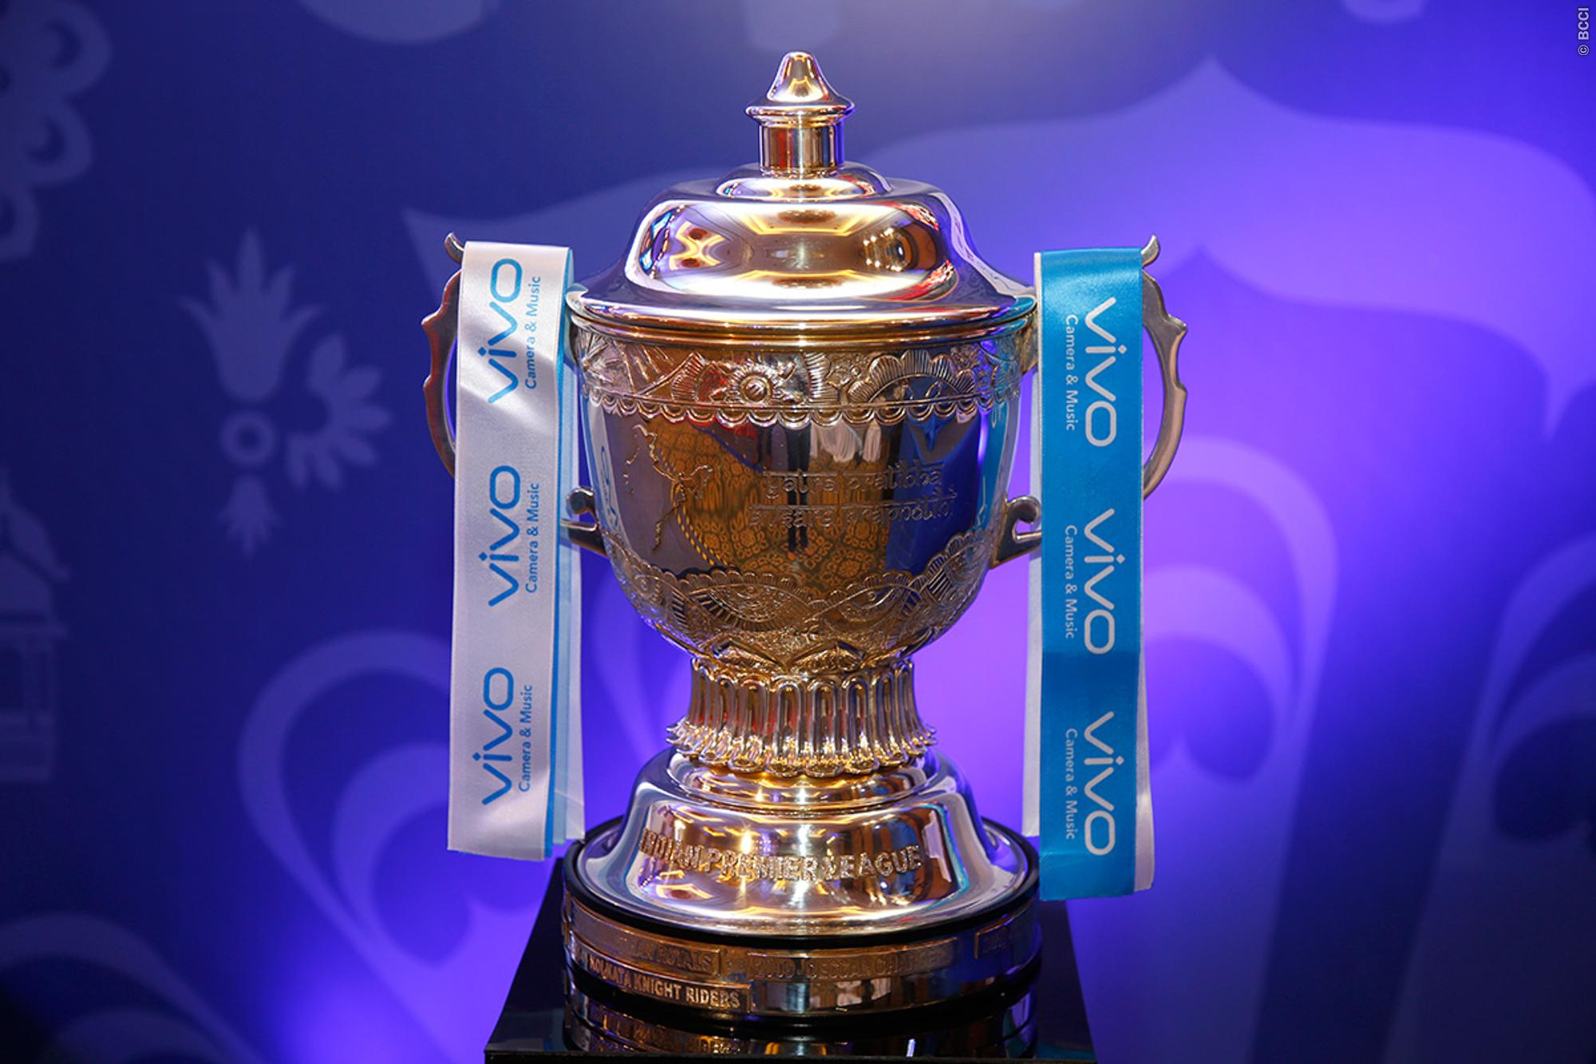

Indian Premier League
By,
Suhas Basavaraju

Slide 2

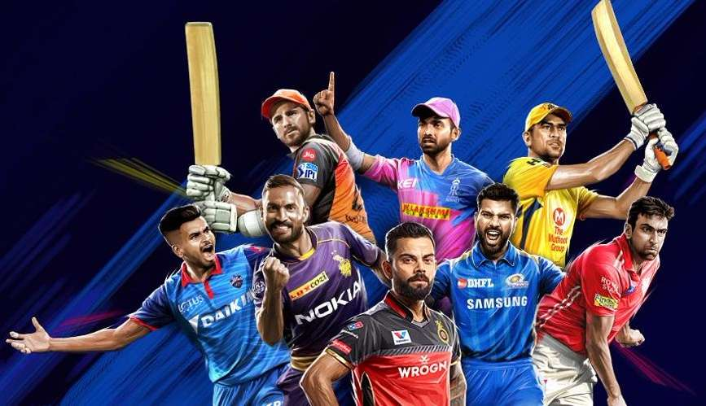
A T20 cricket league known as the Indian Premier League, or IPL, was established in 2008 and is played annually. Eight teams from eight Indian cities compete against one another in a double round-robin format during the league rounds, which are followed by playoffs. It attracts both national and international players. The IPL has grown over time to be among the most watched and attended live sporting events worldwide.

Slide 3

Target Audience
Cricket enthusiasts and fans
Researchers and academics
IPL team owners, coaches, and players
Sports media and journalists
Betting and gambling firms

Slide 4

Research Question
What are the key factors that contribute to the success of teams in the Indian Premier League (IPL) across different seasons, venues, and game situations?

Slide 5

The objective of this project is to examine the IPL dataset to investigate the relationships between a number of performance metrics
Metric includes the results of the toss, the biggest victories, the highest totals, the contenders for the orange and purple caps, boundaries hit, team performance, and win percentages in home and away matches.
The outcomes of this study could assist clubs and players in better comprehending the elements necessary for IPL success and in selecting their teams and strategies.

Slide 6
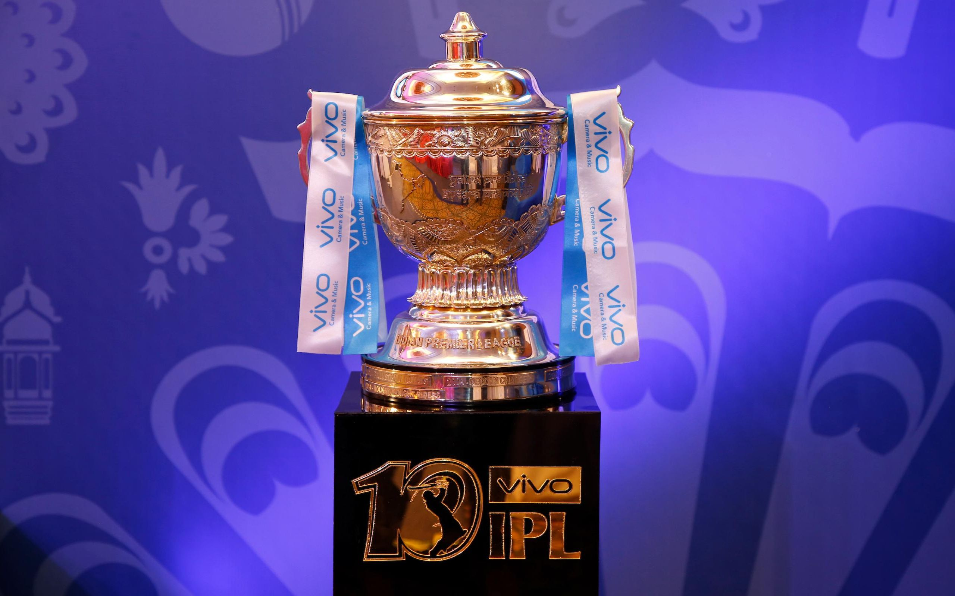
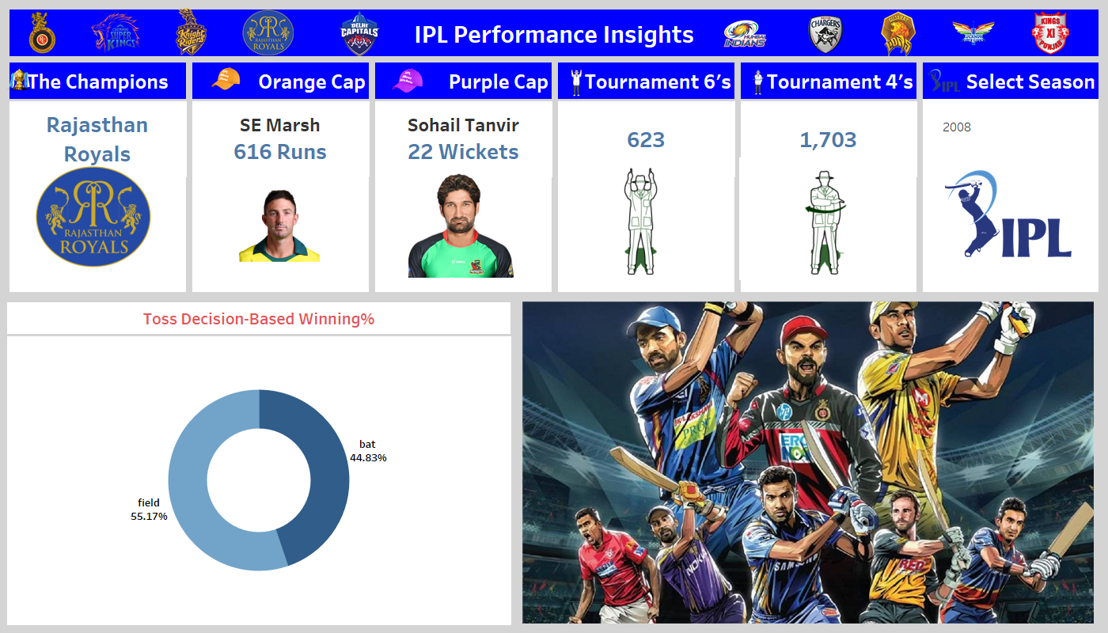

Slide 7

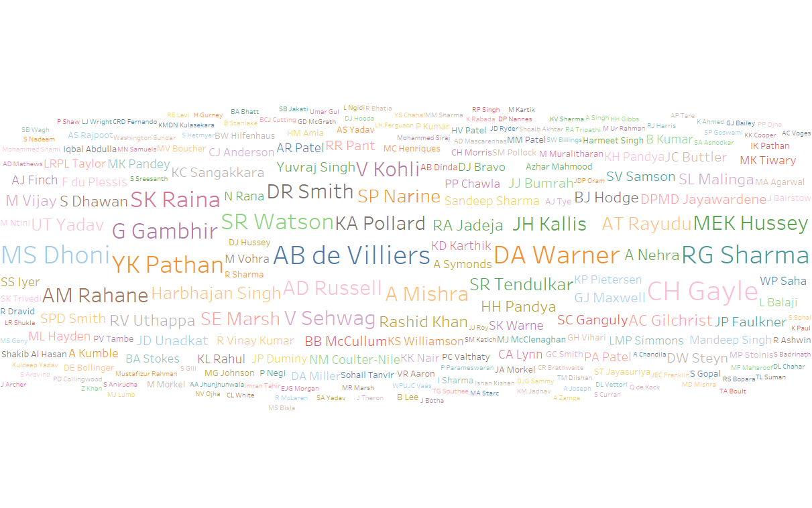
AB de Villiers, MS Dhoni, DA Warner, RG Sharma, CH Gayle, SK Raina, and V Kohli are some of the key players who have been consistent in their performance and led their teams to victories.

Slide 8

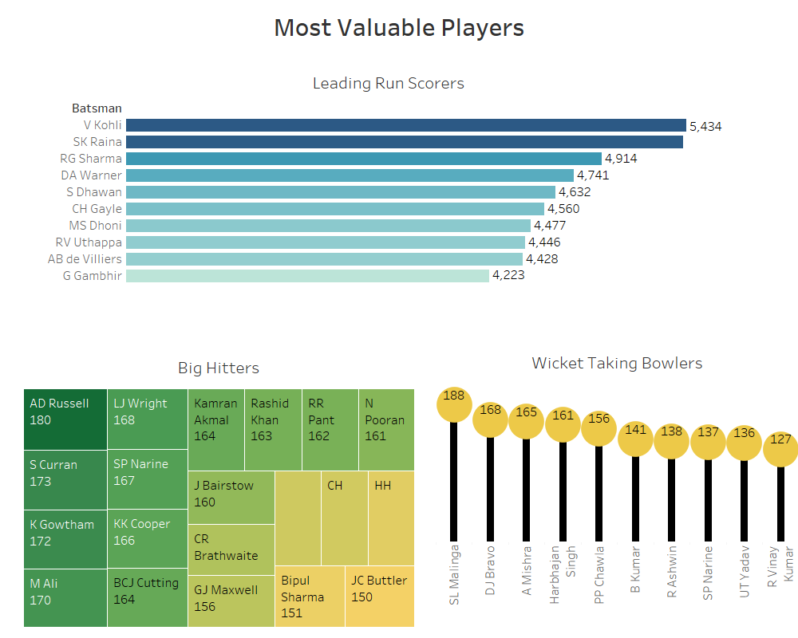
V Kohli is a leading run scorer to date (2019) putting 5434 runs on board closely followed by SK Raina, and RG Sharma.
When it comes to Big Hitters, AD Russel and S Curran stand out with their SR of 180 and 173 and are well-known as "Finishers"
SL Malinga who has been commonly known as "Specialist Death Bowler" has secured 188 Wickets and stands at the top of the Bowler's list followed by DJ Bravo and A Mishra

Slide 9
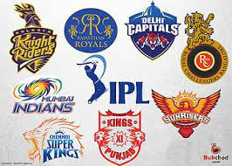
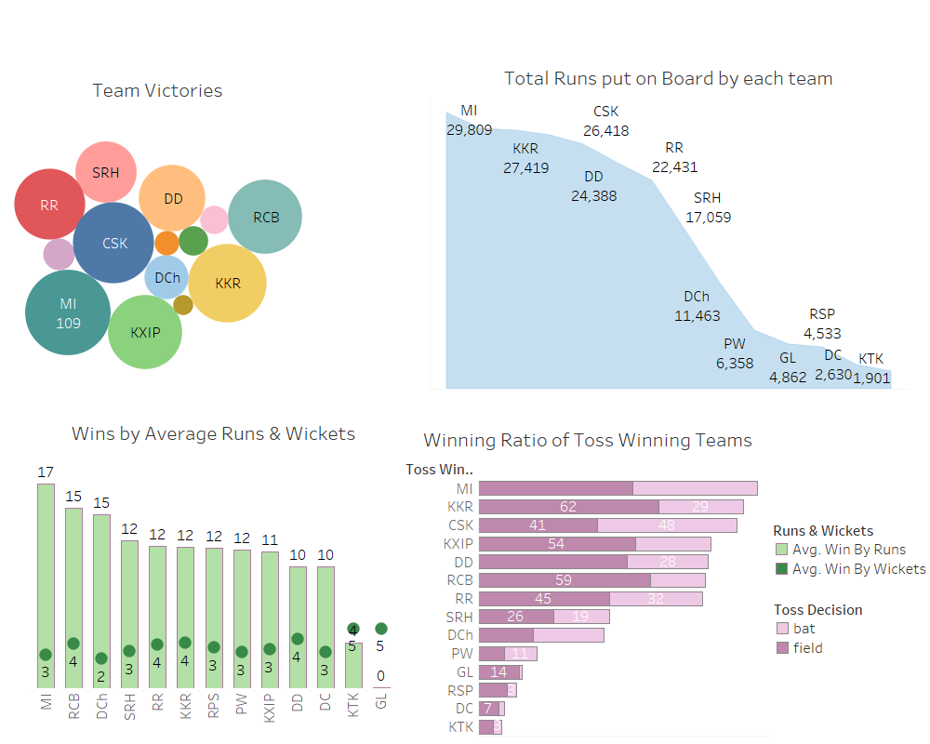
Team Stats
MI has Won the maximum number of Matches with a huge number of 109 followed by CSK, KKR, and RCB.
The same team has secured the top 3 positions of High Run Scorers. KTK which played only in 1 season (2011) has put 1901 runs on board.
RCB has good stats of avg wins by runs and wickets with 15 and 4 respectively.
DD and RCB are more likely to win the match when they decide to field first.

Slide 10
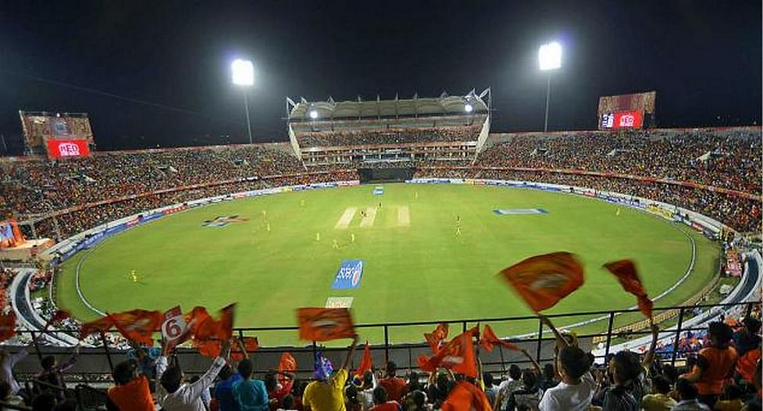
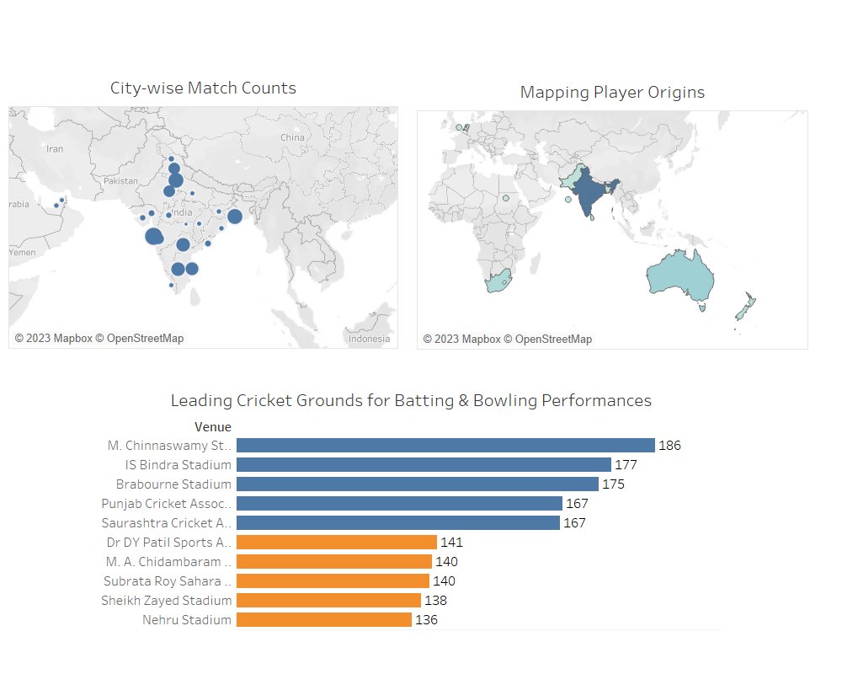
Geographical Analysis
Most matches are played in 4 popular cities namely Mumbai, Delhi, Bangalore, and Hyderabad
International players are majorly from Australia and South Africa. Players from other Countries such as Sri Lanka, West Indies, and New Zealand also actively participated in IPL.
Chinnaswamy, IS Bindra, and Brabourne Stadiums are known as Batting Pitch Grounds, and Chidambaram, DY Patil, and Nehru stadiums are known as Bowling Pitch Stadiums

Slide 11
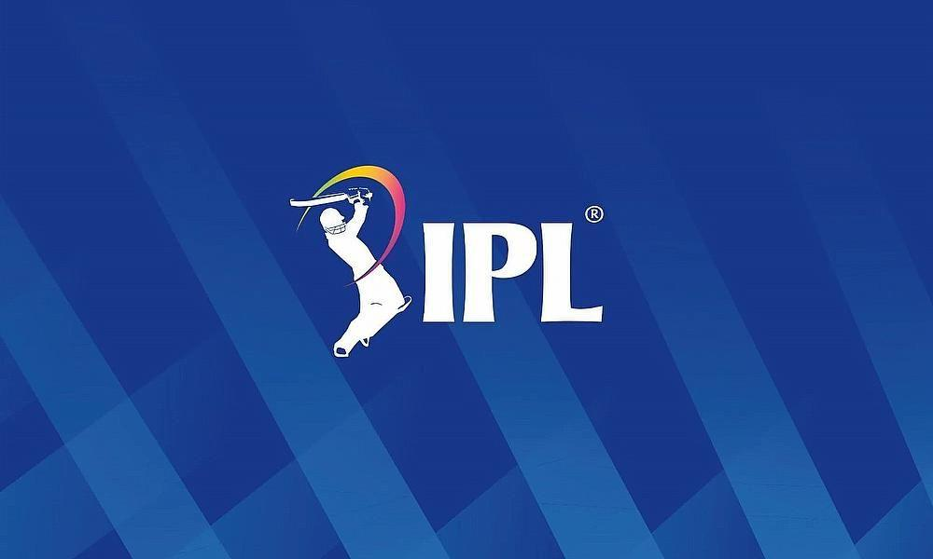
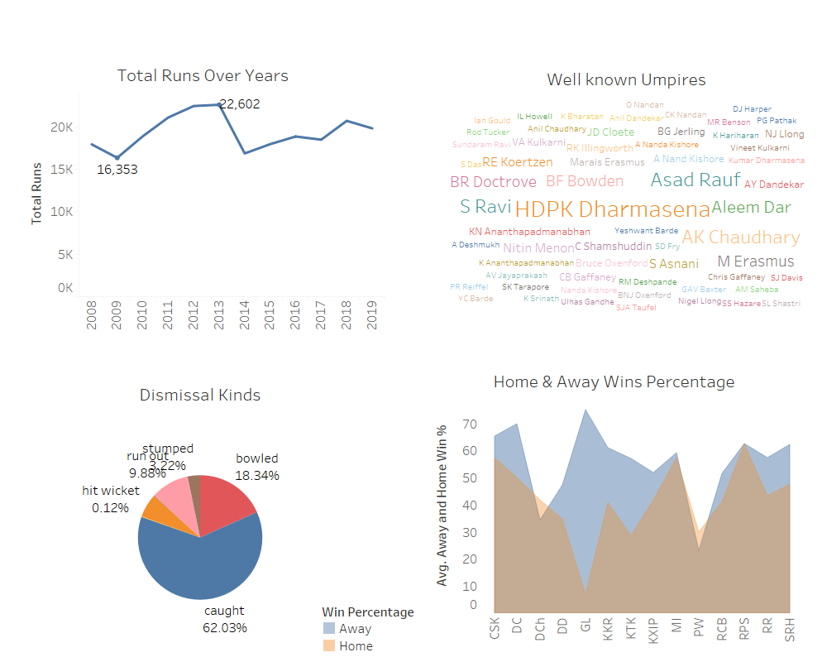
Other Noteworthy Insights
The min and max total runs occurred in the years 2009 and 2013.
Umpires HDPK Dharmasena, Asad Rauf, S Ravi, and AK Chaudhary have made significant contributions to the league.
More than 60% of the players are dismissed by caught. Sadly, some of the players are dismissed by hit wicket too.
It is surprising to see that that analysis reveals that the winning percentage of most of the teams is high when played away compared to their own ground.

Slide 12

Let’s build our own team
V Kohli
DA Warner
RG Sharma
SK Raina
AB de Villiers
AD Russel
DJ Bravo
Rashid Khan
SP Narine
B Kumar
Lasith Malinga
Lose or Win, RCB Forever

Slide 13

Further Analysis
In terms of more complex next steps, machine learning algorithms could be developed to predict future match outcomes and identify potential areas for improvement in team strategies.
Additionally, the project could benefit from the integration of natural language processing techniques to enable users to query the data and obtain specific insights of interest

Slide 14
Thank
You

